Slide 1

MITEL
UC360 COLLABORATION POINT

Slide 2

WHY IS COLLABORATION SO IMPORTANT?
Companies that use advanced UCC technologies gain a clear competitive advantage
Of those companies that have deployed UCC tools:
    72 percent say that they have experienced better performance
    77 percent believe UCC technologies enhance employee mobility
    86 percent say the tools have improved innovation within the organization
Source: Frost and Sullivan, 2012
Notes:
2

Slide 3
THE COLLABORATION GAP
Personal Collaboration Tools
Video Conferencing & Telepresence
THE GAP
Small groups
Personal office
Spontaneous use
Low TCO
Individual Use
Easily accessible
Spontaneous use
Low TCO
Larger groups
Limited resource that requires scheduling
Special occasions
High TCO

Slide 4

CUSTOMER CHALLENGES:
COLLABORATION
WHAT WE HAVE HEARD… END USERS

Slide 5

  “I would like collaboration to
  be a regular part
  of my day – not a special event…”
  “I have to leave my office to properly collaborate…”
  “Sometimes I spend more time trying to figure out how the system works than actually collaborating…”
  “It’s always difficult to find
  an available meeting room when I need it…”
  “Shared space collaboration systems are
  difficult to use…
  I don’t bother…”

Slide 6

CUSTOMER CHALLENGES:
COLLABORATION
WHAT WE HAVE HEARD… BUSINESS MANAGERS

Slide 7

  “My employees are not collaborating enough…”
  “I need to cut travel and accommodation costs…”
  “I need to make my team more accessible to key partners and customers…”
  “Managing teams in distributed locations… and maintaining close working relationships
  is always a challenge...”

Slide 8

CUSTOMER CHALLENGES:
COLLABORATION
WHAT WE HAVE HEARD… IT MANAGERS

Slide 9

  “I spend too much money / time supporting users
  in meetings and collab sessions
  that can’t figure
  out the system…”
  “It costs too much to properly equip all of our meeting rooms with proper collaboration systems…”
  “Deploying new collab systems is always a challenge. Why can’t it be simple?”

Slide 10

CUSTOMERS NEED: SIMPLER COLLABORATION
Easy to use
Ready when I am
Cost effective
Easily to deploy and support
Leverages my existing investments

Slide 11
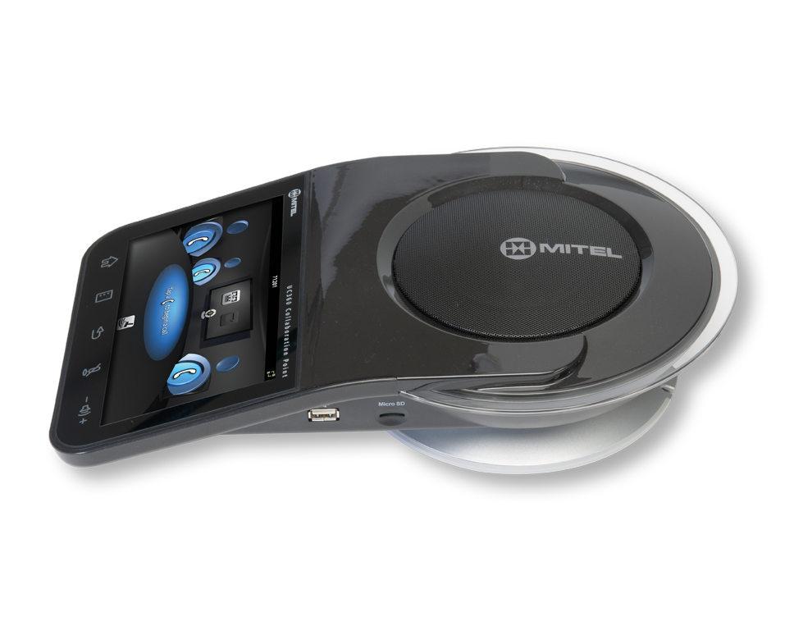
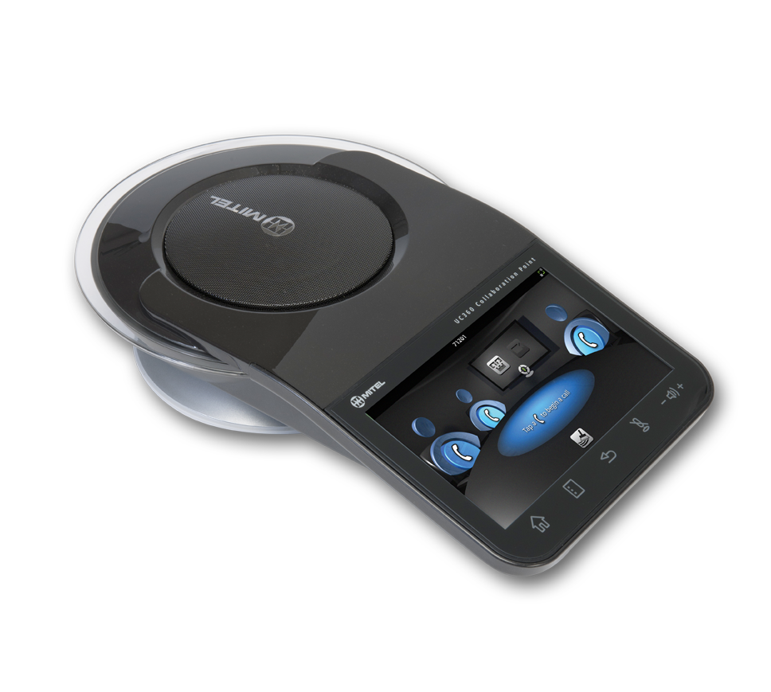
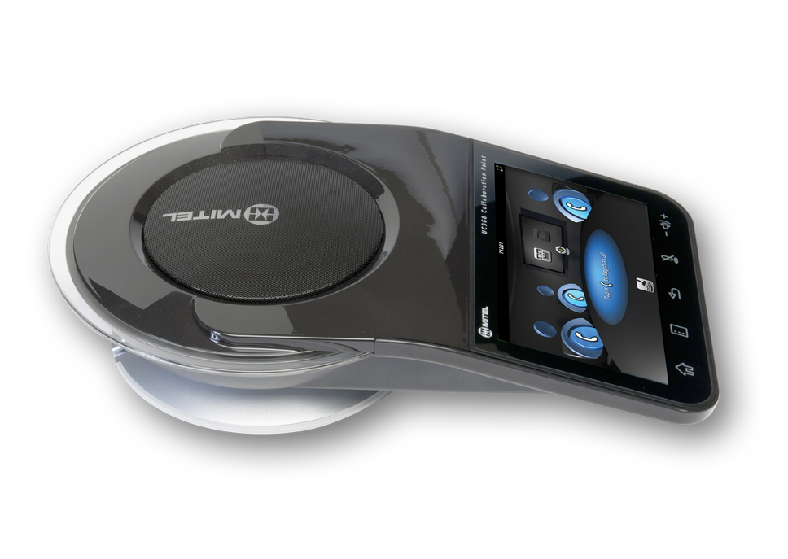
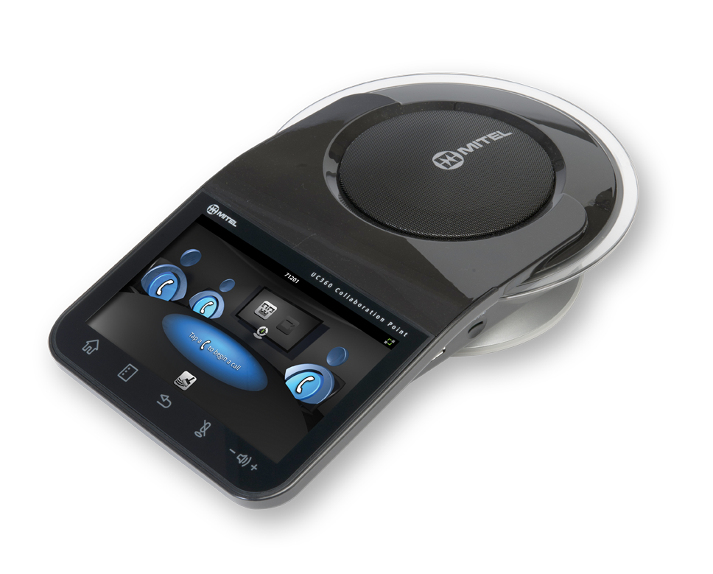
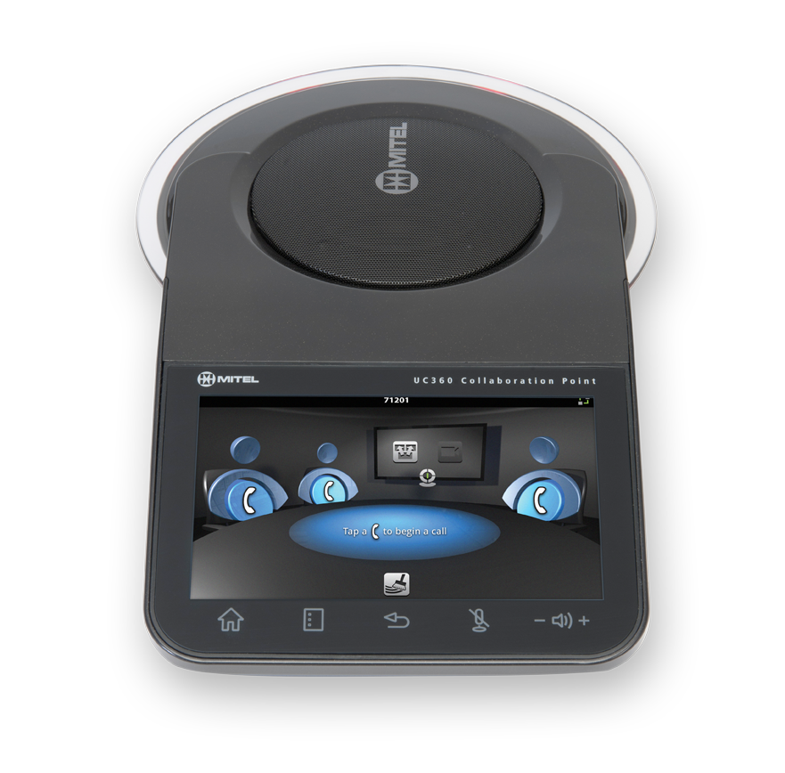
MITEL UC360 COLLABORATION POINT
THE VOICE OF OUR CUSTOMERS

Slide 12
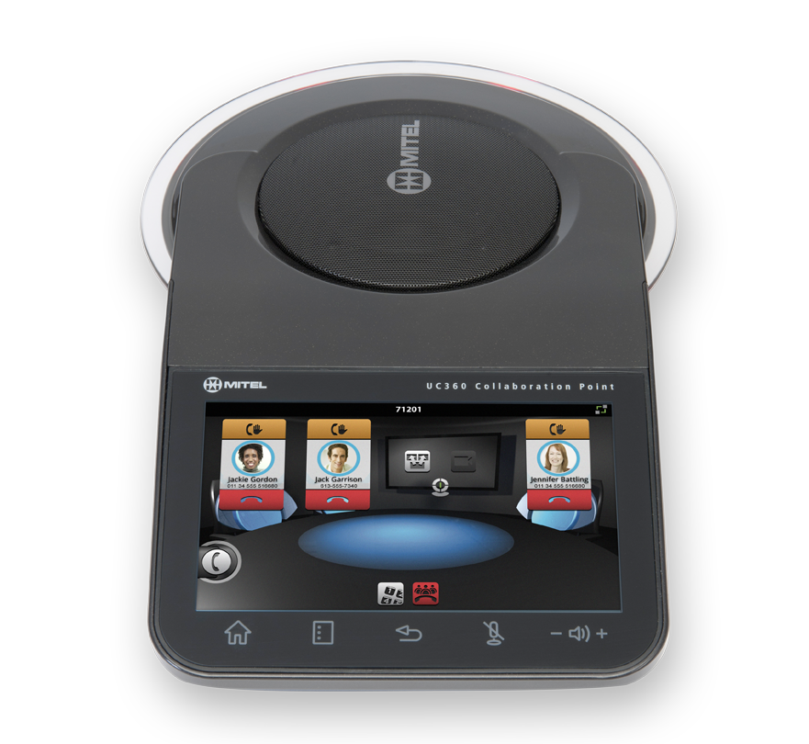
MITEL UC360 COLLABORATION POINT
THE VOICE OF OUR CUSTOMERS
A new device category…
  All-in-one multimedia collaboration appliance for the personal office meeting space
    Multi-party audio and video collaboration
    In-room presentation delivery
    Remote document sharing
  Easy-to-use and simple to deploy
  Improve collaboration and reduce operating costs
  Accessible collaboration with existing communications infrastructure

Slide 13
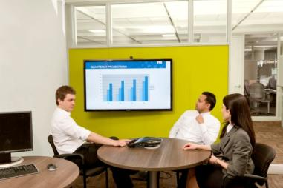
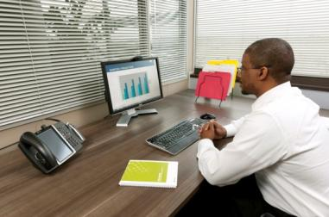
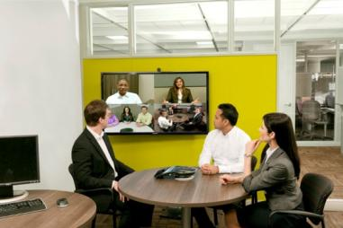
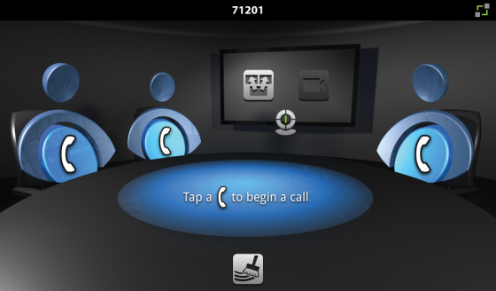
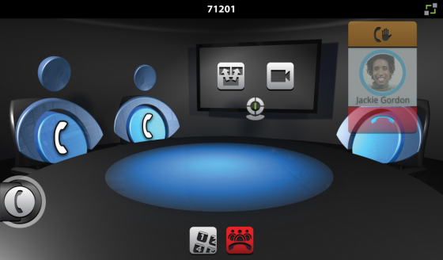
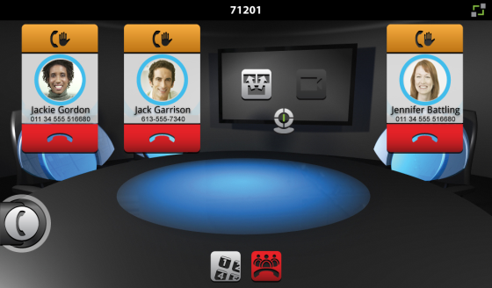
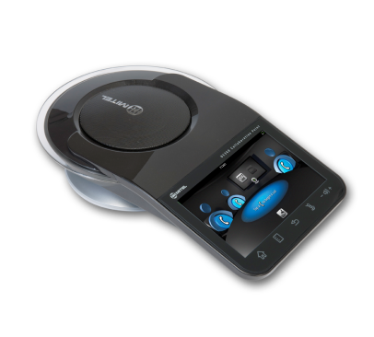
MITEL UC360 COLLABORATION POINT
FOR THE PERSONAL OFFICE MEETING SPACE
In-Room Presentation Management and Display
Audio Conferencing with Remote Collaboration
Full Multimedia Collaboration
Make collaboration a natural part of your day

Slide 14

BUSINESS VALUE

Slide 15
BUSINESS VALUE
USER
Simplify Meetings and Presentations
Improve Collaboration
Enhance Productivity and Innovation
BUSINESS MANAGER
Improve Employee Productivity
Reduce Costs
IT MANAGER
Deploy Easily
Reduce Costs

Slide 16
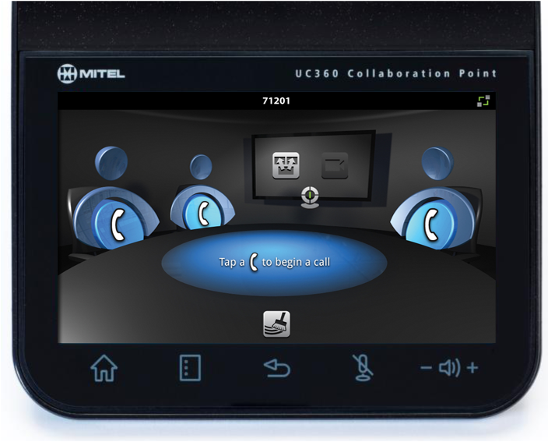
USER
SIMPLIFY MEETINGS AND PRESENTATIONS
Facilitates internal and external meetings
Manage meeting / presentation from one
spot – regardless of disparate equipment types
No desktop computer or laptop needed
Start multi-party audio or collaboration sessions as simply as a phone call
Notes:
End User:
Simplify meetings and presentations
UC360 facilities any meeting or presentation type – internal or external
It provides a single spot to manage the entire meeting or presentation
Meaning your presentation material, the display, and external audio and collaboration
You are able to quick-start a presentation or meeting regardless of the disparate types of equipment being used in those locations (projector or screen, camera, connections, etc.)
No desktop computer or laptop required for me to present (RDP, memory stick, cloud-ready: Dropbox, Google Docs)
Start multi-party audio or collaboration sessions as simply as a phone call.
Intuitive user interface provides zero learning curve for users.
No confusion / intimidation for casual users.
No more time lost to administration at the beginning of every conference call/presentation.

Slide 17
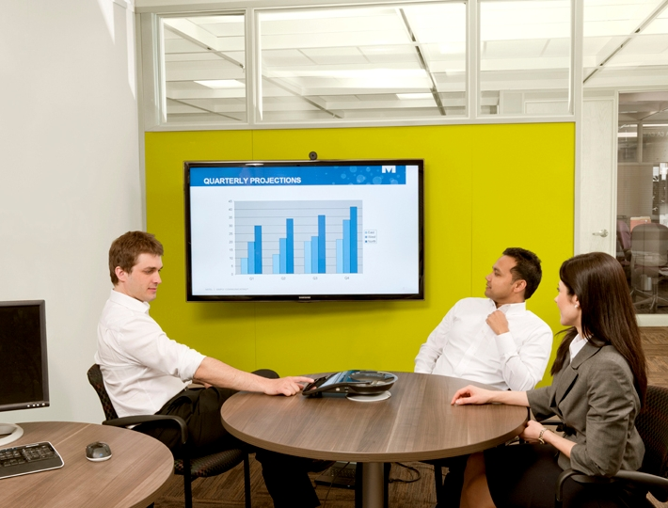
USER
IMPROVE COLLABORATION
Increased use and better collaboration
More spontaneous collaboration
Collaboration becoming the natural way to work
“Face-to-face” interaction for remote participants
Workers in widely dispersed locations form productive long-term and ad hoc teams
Notes:
Simplicity of use removes the barriers of use and leads to:
Increased use and better collaboration.
More spontaneous (in-the-moment) collaboration.
Collaboration becoming the natural way I work.
HD audio and HD video capability provides the value of a more “face-to-face” interaction for remote participants.
Promotes clear understandings of what is being said.
Helps build stronger relationships with easy collaboration and information sharing among employees, customers, partners, and suppliers.
Workers in widely dispersed locations form productive long-term and ad hoc teams as easily as if they were in the same office.

Slide 18
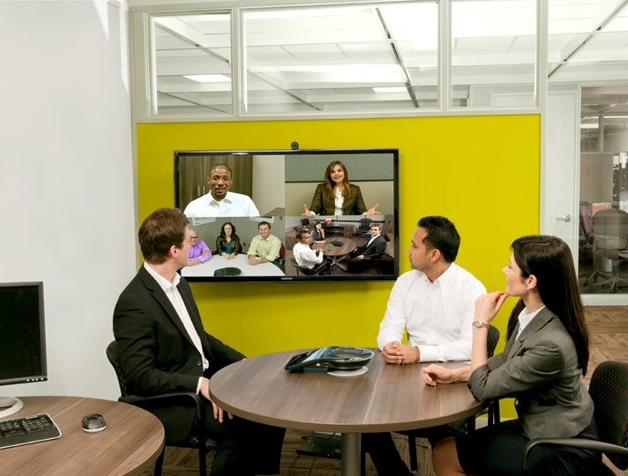
USER
ENHANCE PRODUCTIVITY AND INNOVATION
Spend less time trying to connect with others
Technology doesn‘t get in the way of creativity and innovation
Organize meeting and collaboration sessions
on the fly
More productive brainstorming and training sessions
Notes:
End User:
Enhance Productivity and Innovation
Spend less time trying to connect with others and more time in productive collaboration and innovation.
Technology doesn’t get in the way of creativity and innovation among team members.
Organize meeting and collaboration sessions on the fly with very short notice.
Easy sharing of documents and presentations make for more productive brainstorming and training sessions.

Slide 19
BUSINESS MANAGER
IMPROVE EMPLOYEE PRODUCTIVITY
Enable collab capabilities that employees will actually use
Manage teams in widely dispersed locations
  Develop and maintain closer working relationships
Improve business relationships with best customers / partners by meeting more internal employees
Reduce need for shared meeting spaces
Notes:
Enable collab capabilities that employees will actually use
Manage teams in widely dispersed locations and develop and maintain closer working relationships.
Allow the opportunity for more of your staff to have contact with your customers.
For example, improve your business relationship with your best customers by meeting more of your internal employees.
With UC360 easily deployed in the user’s personal office meeting space, there is no longer as much of a need to use shared meeting spaces.
Most meetings are only with 4 or fewer people which can be accommodated in personal offices.
Equip multiple offices with this solution for less than it would cost to properly equip a meeting room with a video collaboration system.

Slide 20

Business Manager
REDUCE COSTS
Lower travel expenses such as airfare and accommodation
Reduce the loss in productivity from employees being out of the office
Notes:
Business Manager:
Reduce costs
Lower travel expenses such as airfare and accommodation,
And, reduce the loss in productivity from employees being out of the office.

Slide 21
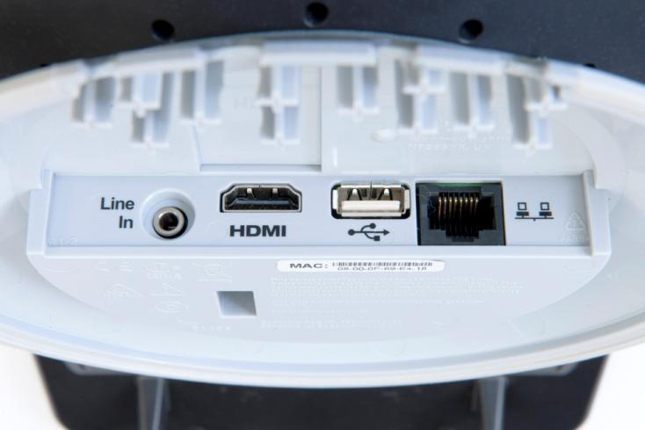
IT MANAGER
DEPLOY EASILY
A single, easy-to-install appliance
Deployment is as simple as plugging in an IP phone
Low cost for widespread deployment
Open, standards-based collaboration
Out of the box interoperability – SIP standards
Open, standards-based multimedia
Notes:
IT Manager:
Deploy Easily
A single, easy-to-install appliance to enhance collaboration in the personal office meeting space
Collaboration enablement is as simple as plugging in a phone.
Low cost allows a more widespread deployment into locations that would not normally be equipped with collaboration capabilities.
Open, standards-based collaboration fits seamlessly with my existing infrastructure
Mitel or other PBX
Video solutions
Computing environment
Cloud-ready
Dropbox and Google Docs
Out of the box interoperability with – SIP standards

Slide 22

IT MANAGER
REDUCE COSTS
Cost effective + use existing hardware or source non-proprietary components
Reduce support calls from end users with meeting room display issues and video conferencing issues
Single device to support in personal offices and meeting rooms
Notes:
IT Manager:
Reduce costs
Cost effective solution + use existing hardware or source commercially available non-proprietary components (camera, display device) for an affordable solution.
Reduce support calls from end users with meeting room display issues and collaboration system issues.
Single device to support in personal offices and meeting rooms.

Slide 23
KEY DIFFERENTIATORS
New device category with disruptive price point
“Zero learning curve” user interface
Superior audio quality
Unique in-room presentation delivery
Simple to deploy – as easy as plugging
in an IP phone
Notes:
This is a completely new device category with disruptive price point
The device is actually less than $2,000.
It is incredibly easy to use with our “Zero learning curve’ user interface
It provides superior audio quality compared to competitor audio conference phones
It was designed specifically to provide an exceptional HD audio experience
If we even simply compare UC360 to a high-end competitor conference phones, in-room presentation delivery is not available on any of these devices.
And the device is very simply to deploy.
It Interops with other communications platforms and video platforms
And it has built-in audio and visual collaboration capability

Slide 24
TECHNICAL OVERVIEW

Slide 25
PLATFORM
Google® Android™-based
Dual 1 GHz processor core with hardware video acceleration
User interface access via 7-inch, high-res multi-touch display
“Zero learning curve” UI

Slide 26
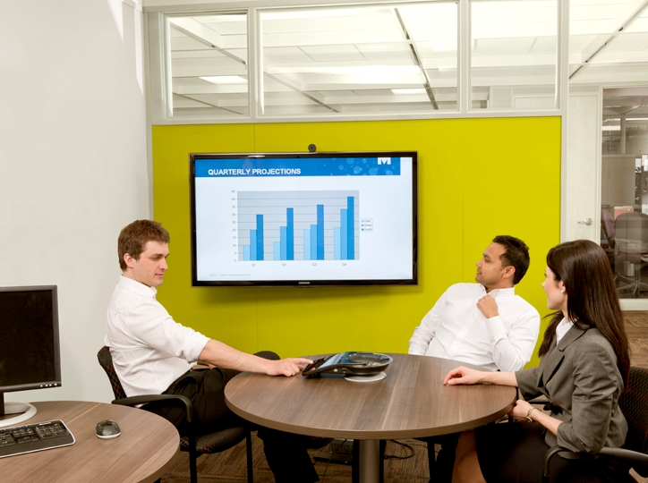
IN-ROOM PRESENTATION DELIVERY
HDMI Video Interface
  HD Monitor, Flat Screen, Pico / Standard Projector
Picsel® Smart Office™
  View / Edit Microsoft® Office Docs
No laptop required
  Remote Desktop Access
  USB and Micro SD card
  Cloud-ready: Dropbox
  and Google Docs™
One spot to manage the entire presentation

Slide 27
AUDIO CONFERENCING
Built-in four-party audio bridge
22 KHz HD audio support
16 mic beam-forming array
Dedicated Digital Signal Processor (DSP)
Corporate directory access
Superior audio performance
Notes:
Built-in 4-party audio bridge
22KHz HD audio support
16 mic beam-forming array
Dedicated Digital Signal Processor (DSP)
Adds to the superior audio quality
Easy access to the corporate directory access with a quick search interface

Slide 28
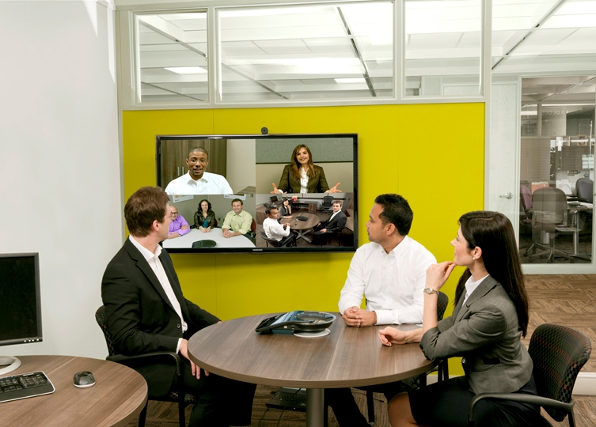
VISUAL COLLABORATION
Presentation display to remote participants
Built-in four-party HD
video bridge
Support for ethernet
camera up to
720p x 30 fps
SIP Interop
Easier, more spontaneous multimedia collaboration

Slide 29

FLEXIBLE INTEROPERABILITY
Open, standards-based collaboration fits seamlessly with existing infrastructures
  Mitel® or other PBX
  Video solutions
  Computing environment
  Cloud-ready
    Dropbox and Google Docs

Slide 30
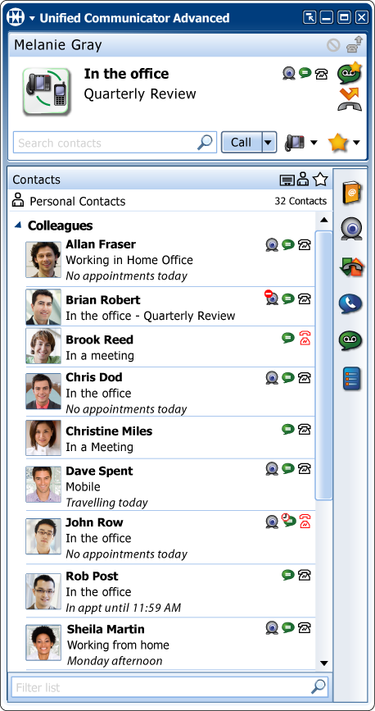
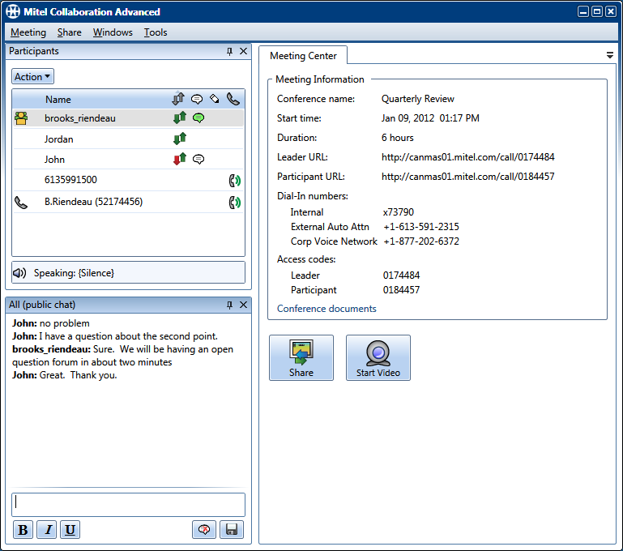
FIT WITH MITEL UCC SOLUTIONS
Audio conference with Mitel Communications Director (MCD) and Mitel Collaboration Advanced (MCA)
Include in MCD PRG
Manage with Mitel Unified Communicator® Advanced (UCA)
  Presence
  Dynamic Status
  Click to call
Notes:
When integrated with Mitel UCC Solutions UC360 supports:
Users dialing into audio conference calls on Mitel communications platforms and desktop collaboration application, Mitel Collaboration Advanced (MCA).
It can be included in Mitel Personal Ring Groups and seamlessly managed by Mitel’s award-winning unified communications application, Unified Communicator Advanced (UCA), so calls reach you based on your presence and availability.

Slide 31
Voice of the Customer
WHAT Customers Have to Say about UC360

Slide 32
  “Mitel UC360 makes collaboration with a co-worker miles away as easy as with someone just down the hall…”
  Rachel Konar, VP Client Services, Brandcierge
  “Mitel UC360™ setup is a breeze, which makes for quick and easy deployment wherever they are needed…”
  Rick DeClerk, Manager, Network Communications, Central Technology Services
  “With Mitel UC360, we can be in a productive collaboration session in less time than it used to take us to book a conference room…”
  Jason Spainhour, Director of Information Systems, SkillPath Seminars

Slide 33
THANK YOU
The information conveyed in this presentation, including oral comments and written materials, is confidential and proprietary to Mitel® and is intended solely for Mitel employees. If you are not a Mitel employee, you are not the intended recipient of this information and cannot view the presentation. Please delete or return any related material. Mitel will enforce its rights to protect its confidential and proprietary information, and failure to comply with the foregoing may result in legal action against you or your company.

